Slide 1
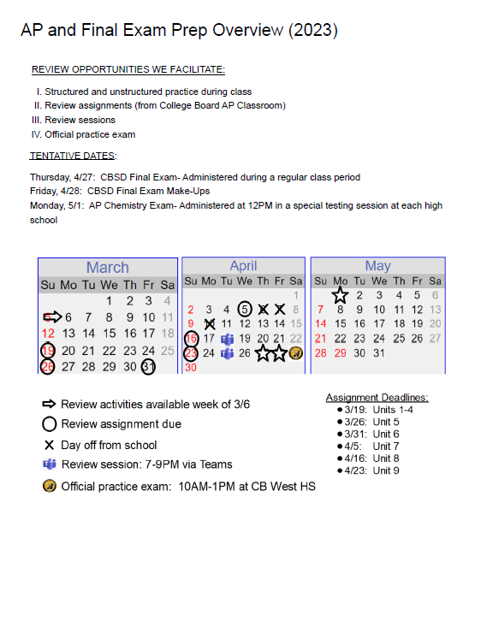
6:30–6:45pm
Welcome to Back-to-School Night 1st Block AP Chemistry, A223 Terri Mehalick
Please add your name to the sign-in sheet on the clipboard & take a copy of tonight’s handout.
Please reach out to me at any time: tmehalick@cbsd.org
For your reference, tonight’s PowerPoint will be posted on my SchoolWires site: https://www.cbsd.org/tmercer

Slide 2
6:50–7:00pm
Welcome to Back-to-School Night 2nd Block AP Chemistry, A223 Terri Mehalick
Please add your name to the sign-in sheet on the clipboard & take a copy of tonight’s handout.
Please reach out to me at any time: tmehalick@cbsd.org
For your reference, tonight’s PowerPoint will be posted on my SchoolWires site: https://www.cbsd.org/tmercer

Slide 3
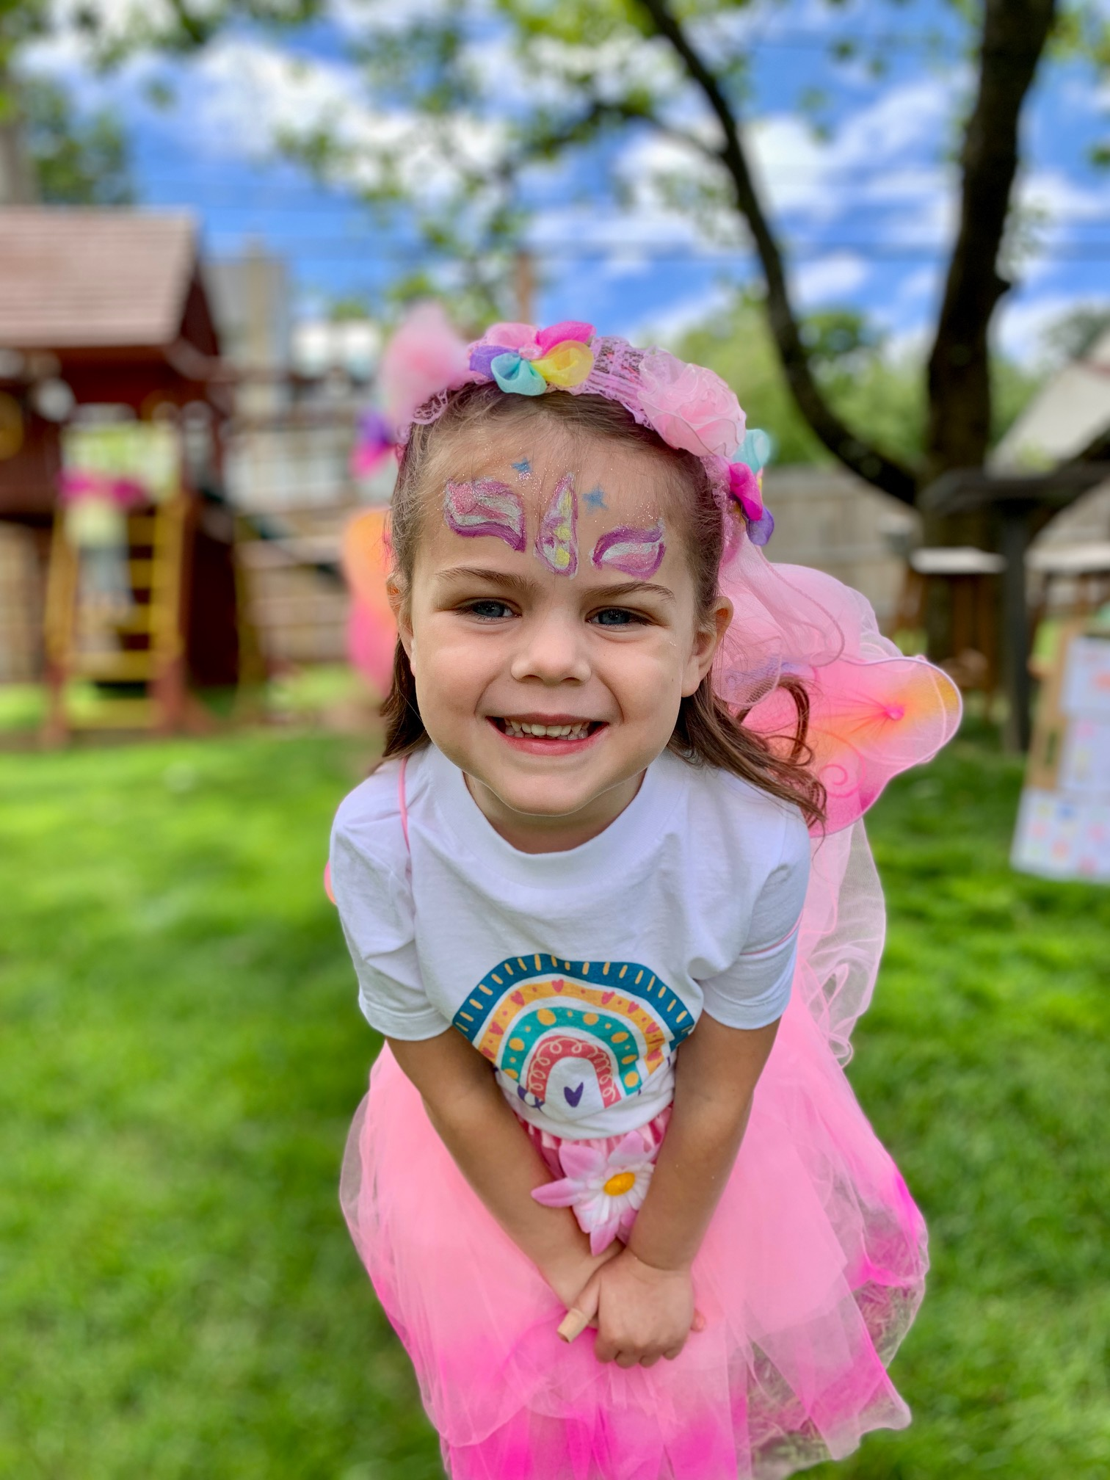
Terri Mehalick Conceptual, Academic, Honors, & AP Chemistry
Cabrini University M. Ed. (2016)
CB West High School
Fall ’14 – Present
CB East High School
Spring ’14 – Spring ’15
CB South High School
Fall ’12 – Spring ’14
Pennsylvania State University B.S. Secondary Education, Chemistry option (2012)

Slide 4
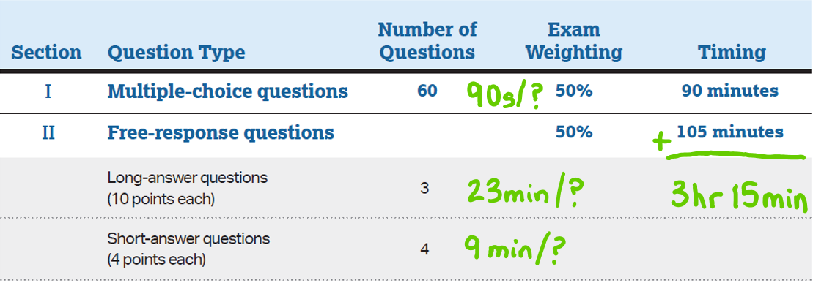
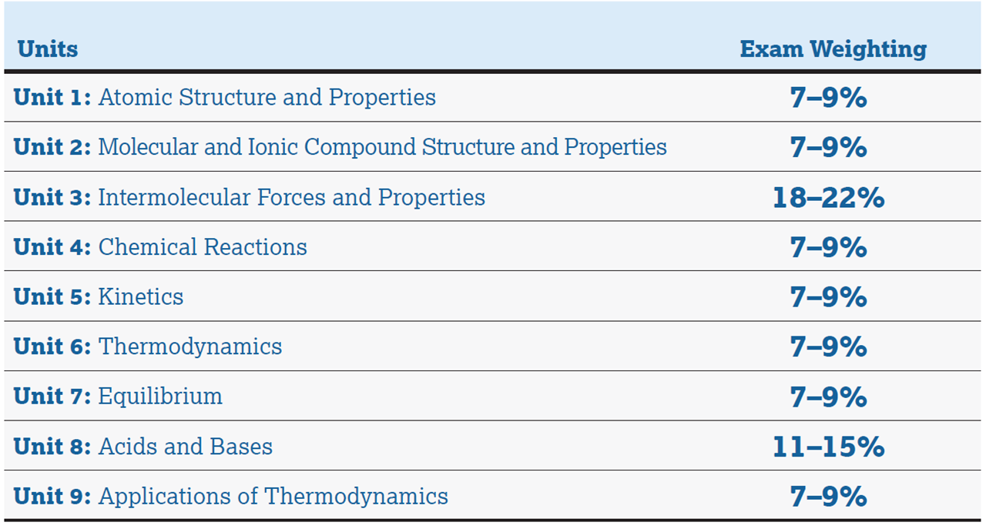
AP Chemistry Exam: Monday May 1st @ 12:00pm
calculator permitted for entire exam
*no penalty for guessing, so answer EVERY question*

Slide 5
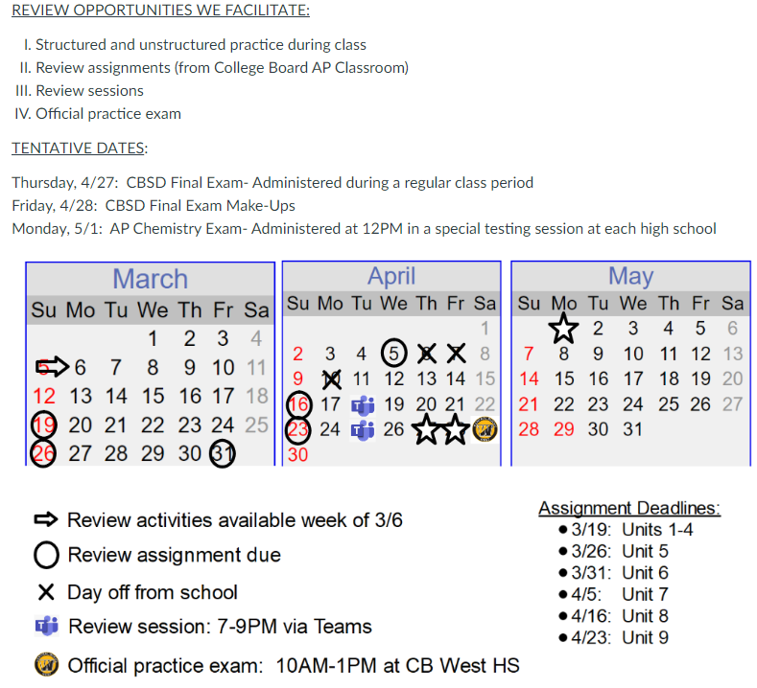
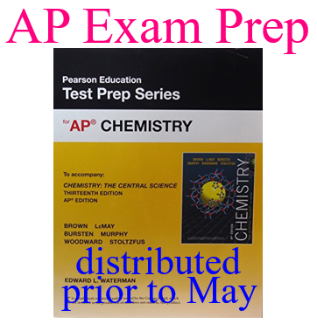

Slide 8
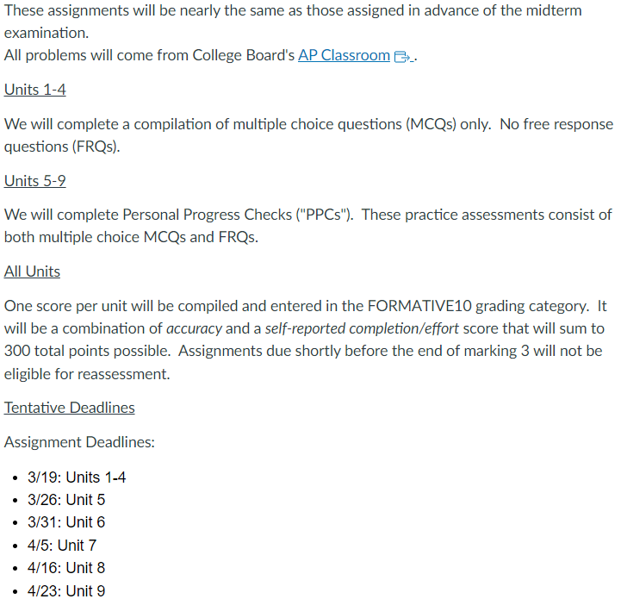
FRQ PPCs are accompanied by scoring guidelines: Students self-score using guidelines Students encouraged to track progress & “trouble spots”

Slide 9
MC PPCs provide targeted feedback for each student: Overall score for quiz Score for each topic & skill within that unit Points awarded per question Selected answer, correct answer, explanation Links to similar questions in that PPC, related content & skills, & suggested instructional videos

Slide 10
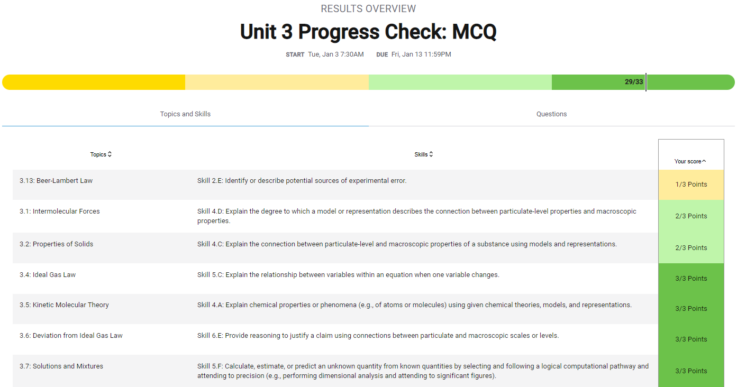

Slide 11
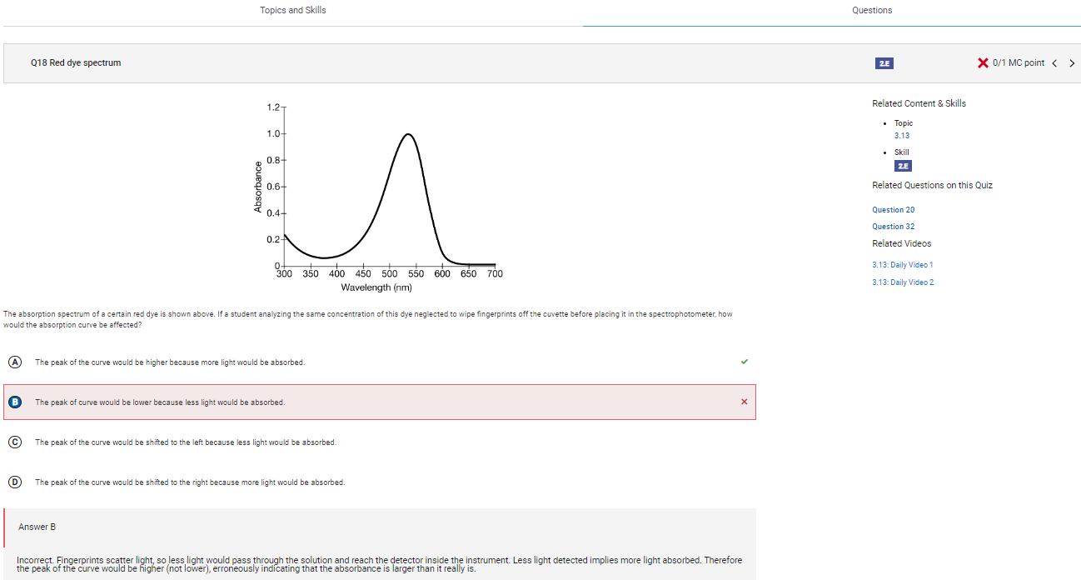

Slide 12
Global AP Chemistry Exam Scores
2022
2021
2020
2018
2017
2016

Slide 13
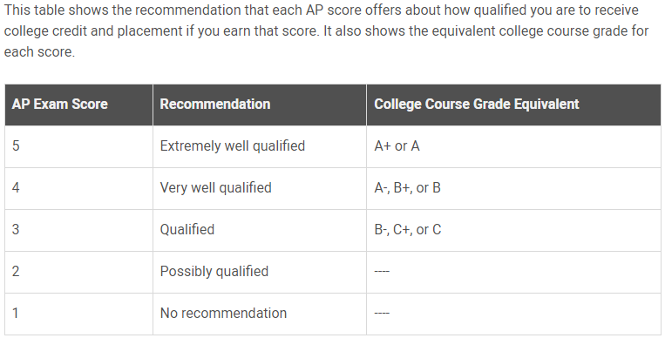
What Do These Scores Mean?

